Slide 2
Digital Circuits Design Fundamentals
Chapter 4
Combinatorial Functions
and Circuits
Fei Wang, 2024
Chapter 2 - Part 1 <number>

Slide 3
Overview
Functions and functional blocks
Rudimentary logic functions
Decoding
Encoding
Selecting
Implementing Combinational Functions Using:
  Decoders and OR gates
  Multiplexers (and inverter)
  ROMs
  PLAs
  PALs
  Lookup Tables
Chapter 4 <number>

Slide 4
Functions and Functional Blocks
The functions considered are those found to be very useful in design
Corresponding to each of the functions is a combinational circuit implementation called a functional block.
In the past, many functional blocks were implemented as SSI, MSI, and LSI circuits.
Today, they are often simply parts within a VLSI circuits.
Chapter 4 <number>

Slide 5
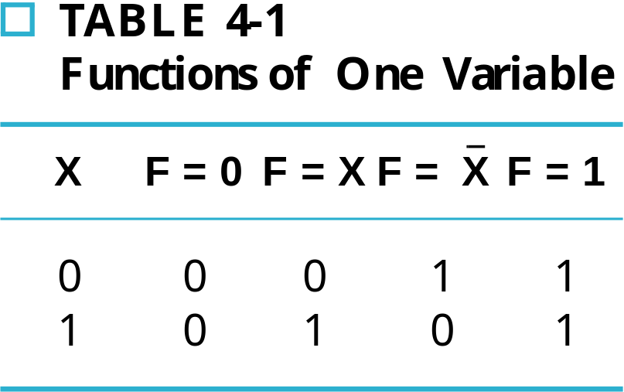
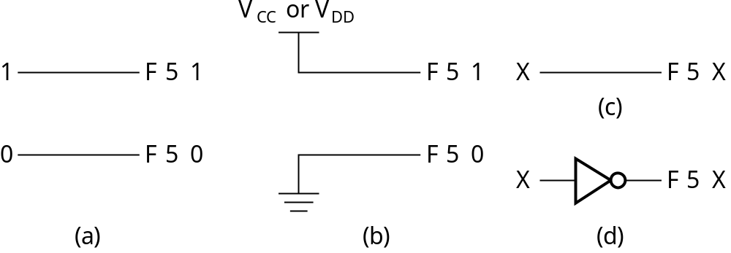
Rudimentary Logic Functions
Functions of a single variable X
Can be used on the
inputs to functional
blocks to implement
other than the block’s
intended function
Chapter 4 <number>

Slide 6
Multiple-bit Rudimentary Functions
Multi-bit Examples:
A wide line is used to represent
a bus which is a vector signal
In (b) of the example, F = (F₃, F₂, F₁, F₀) is a bus.
The bus can be split into individual bits as shown in (b)
Sets of bits can be split from the bus as shown in (c)
for bits 2 and 1 of F.
The sets of bits need not be continuous as shown in (d) for bits 3, 1, and 0 of F.
A
F
A
3
3
2
1
F
1
2
4
4
2:1
F(2:1)
2
F
0
F
0
F
1
1
A
0
(c)
F
0
A
(a)
(b)
3
4
3,1:0
F(3), F(1:0)
F
(d)
Chapter 4 <number>

Slide 7
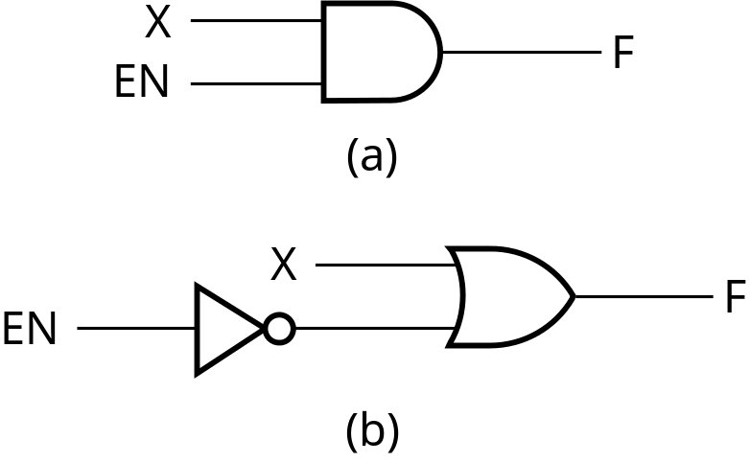
Enabling Function
Enabling permits an input signal to pass through to an output
Disabling blocks an input signal from passing through to an output, replacing it with a fixed value
The value on the output when it is disable can be Hi-Z (as for three-state buffers and transmission gates), 0 , or 1
When disabled, 0 output
When disabled, 1 output
See Enabling App in text
Chapter 4 <number>

Slide 8
Decoding
Decoding - the conversion of an n-bit input code to an m-bit output code with
n ≤ m ≤ 2^{n} such that each valid code word produces a unique output code
Circuits that perform decoding are called decoders
Here, functional blocks for decoding are
  called n-to-m line decoders, where m ≤ 2^{n}, and
  generate 2^{n} (or fewer) minterms for the n input variables
Chapter 4 <number>

Slide 9
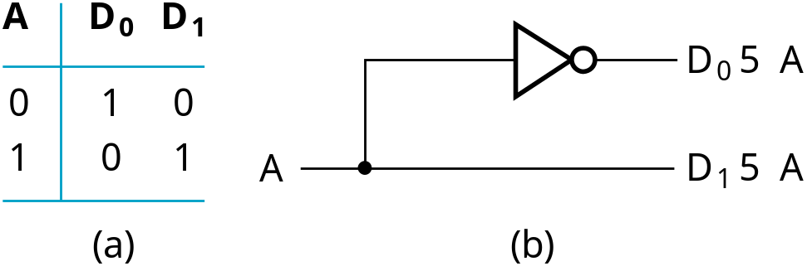
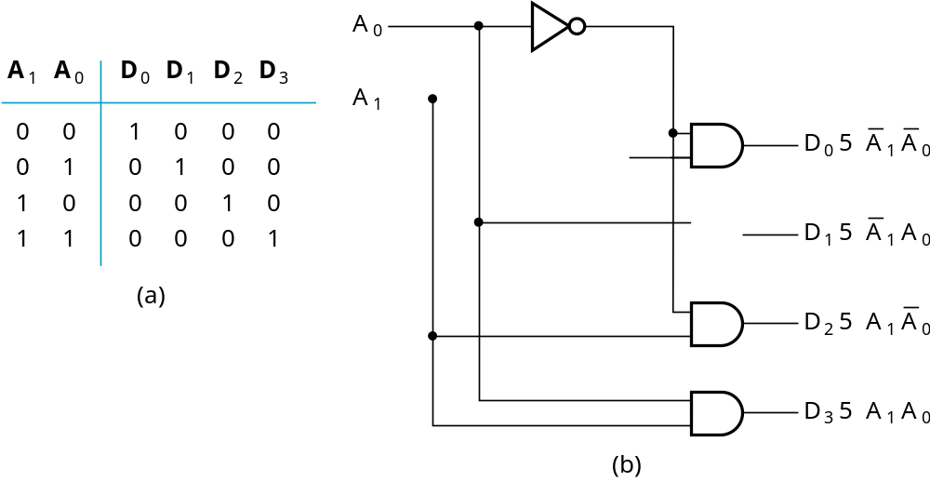
Decoder Examples
1-to-2-Line Decoder
2-to-4-Line Decoder
Note that the 2-4-line
made up of 2 1-to-2-
line decoders and 4 AND gates.
Chapter 4 <number>

Slide 10
Decoder Expansion
General procedure given in book for any decoder with n inputs and 2^{n} outputs.
This procedure builds a decoder backward from the outputs.
The output AND gates are driven by two decoders with their numbers of inputs either equal or differing by 1.
These decoders are then designed using the same procedure until 2-to-1-line decoders are reached.
The procedure can be modified to apply to decoders with the number of outputs ≠ 2^{n}
Chapter 4 <number>

Slide 11
Decoder Expansion - Example 1
3-to-8-line decoder
  Number of output ANDs = 8
  Number of inputs to decoders driving output ANDs = 3
  Closest possible split to equal
    2-to-4-line decoder
    1-to-2-line decoder
  2-to-4-line decoder
    Number of output ANDs = 4
    Number of inputs to decoders driving output ANDs = 2
    Closest possible split to equal
      Two 1-to-2-line decoders
See next slide for result
Chapter 4 <number>

Slide 12
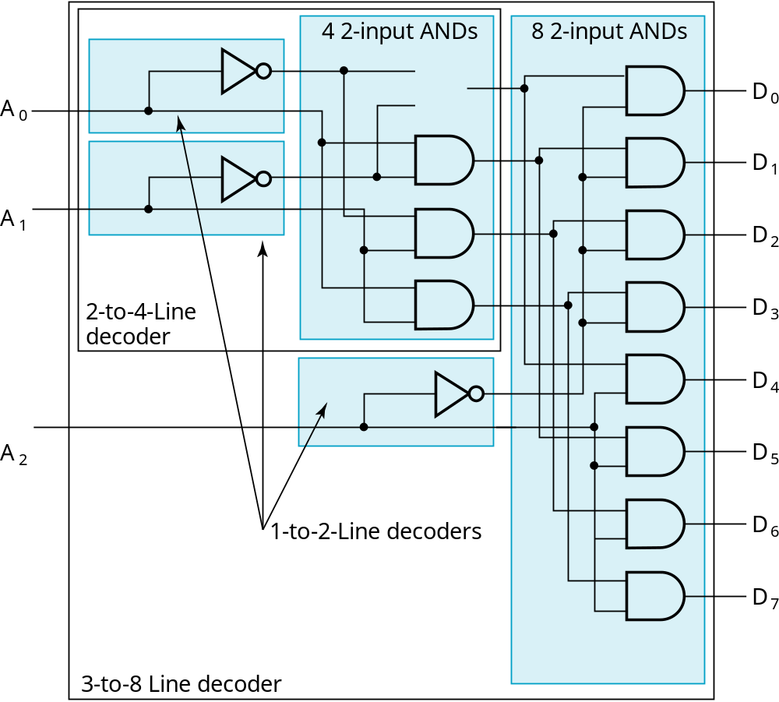
Decoder Expansion - Example 1
Result
Chapter 4 <number>

Slide 13
Decoder Expansion - Example 2
7-to-128-line decoder
  Number of output ANDs = 128
  Number of inputs to decoders driving output ANDs = 7
  Closest possible split to equal
    4-to-16-line decoder
    3-to-8-line decoder
  4-to-16-line decoder
    Number of output ANDs = 16
    Number of inputs to decoders driving output ANDs = 2
    Closest possible split to equal
      2 2-to-4-line decoders
  Complete using known 3-8 and 2-to-4 line decoders
Chapter 4 <number>

Slide 14
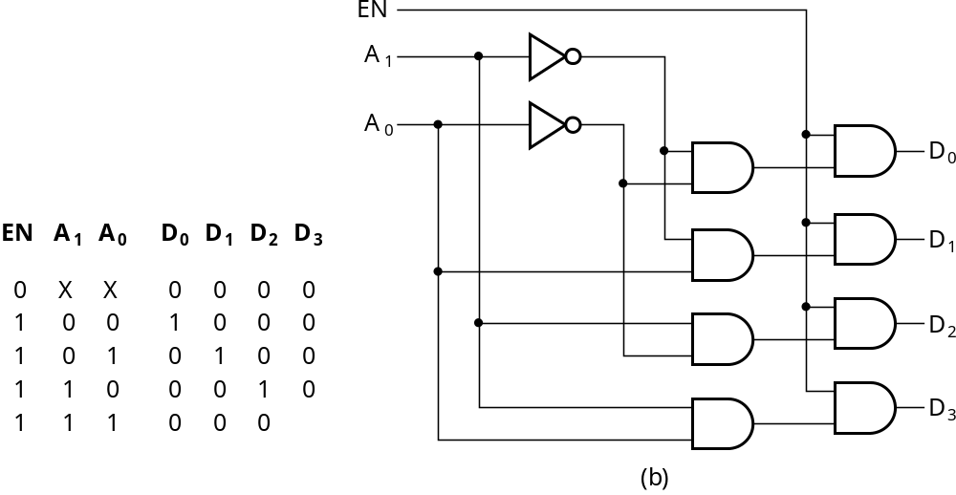
Decoder with Enable
In general, attach m-enabling circuits to the outputs
See truth table below for function
  Note use of X’s to denote both 0 and 1
  Combination containing two X’s represent four binary combinations
Alternatively, can be viewed as distributing value of signal EN to 1 of 4 outputs
In this case, called a
demultiplexer
Chapter 4 <number>

Slide 15
Encoding
Encoding - the opposite of decoding - the conversion of an m-bit input code to a n-bit output code with n ≤ m ≤ 2^{n} such that each valid code word produces a unique output code
Circuits that perform encoding are called encoders
An encoder has 2^{n} (or fewer) input lines and n output lines which generate the binary code corresponding to the input values
Typically, an encoder converts a code containing exactly one bit that is 1 to a binary code corres-ponding to the position in which the 1 appears.
Chapter 4 <number>

Slide 16
Encoder Example
A decimal-to-BCD encoder
  Inputs: 10 bits corresponding to decimal digits 0 through 9, (D₀, …, D₉)
  Outputs: 4 bits with BCD codes
  Function: If input bit D_{i} is a 1, then the output (A₃, A₂, A₁, A₀) is the BCD code for i,
The truth table could be formed, but alternatively, the equations for each of the four outputs can be obtained directly.
Chapter 4 <number>

Slide 17
Encoder Example (continued)
Input D_{i} is a term in equation A_{j} if bit A_{j} is 1 in the binary value for i.
Equations:
  A₃ = D₈ + D₉
  A₂ = D₄ + D₅ + D₆ + D₇
  A₁ = D₂ + D₃ + D₆ + D₇
  A₀ = D₁ + D₃ + D₅ + D₇ + D₉
F₁ = D₆ + D₇ can be extracted from A₂ and A₁ Is there any cost saving?
Chapter 4 <number>
Notes:
No. The total gate input cost remains the same.

Slide 18
Priority Encoder
If more than one input value is 1, then the encoder just designed does not work.
One encoder that can accept all possible combinations of input values and produce a meaningful result is a priority encoder.
Among the 1s that appear, it selects the most significant input position (or the least significant input position) containing a 1 and responds with the corresponding binary code for that position.
Chapter 4 <number>

Slide 19
Priority Encoder Example
Priority encoder with 5 inputs (D₄, D₃, D₂, D₁, D₀) - highest priority to most significant 1 present - Code outputs A2, A1, A0 and V where V indicates at least one 1 present.
Xs in input part of table represent 0 or 1; thus table entries correspond to product terms instead of minterms. The column on the left shows that all 32 minterms are present in the product terms in the table
No. of Min-terms/Row | Inputs |  |  |  |  | Outputs
 | D4 | D3 | D2 | D1 | D0 | A2 | A1 | A0 | V
1 | 0 | 0 | 0 | 0 | 0 | X | X | X | 0
1 | 0 | 0 | 0 | 0 | 1 | 0 | 0 | 0 | 1
2 | 0 | 0 | 0 | 1 | X | 0 | 0 | 1 | 1
4 | 0 | 0 | 1 | X | X | 0 | 1 | 0 | 1
8 | 0 | 1 | X | X | X | 0 | 1 | 1 | 1
16 | 1 | X | X | X | X | 1 | 0 | 0 | 1
Chapter 4 <number>
Notes:
Go over table explaining how entries were obtained, particularly those containing Xs

Slide 20
Priority Encoder Example (continued)
Could use a K-map to get equations, but can be read directly from table and manually optimized if careful:
  A₂ = D₄
  A₁ = D₃ + D₂ = F₁, F₁ = (D₃ + D₂)
  A₀ = D₃ + D₁ = (D₃ + D1)
  V = D₄ + F₁ + D₁ + D₀
D4
D4
D3
D4
D4
D4
D3
D2
D4
D2
Chapter 4 <number>

Slide 21
Selecting
Selecting of data or information is a critical function in digital systems and computers
Circuits that perform selecting have:
  A set of information inputs from which the selection is made
  A single output
  A set of control lines for making the selection
Logic circuits that perform selecting are called multiplexers
Selecting can also be done by three-state logic or transmission gates
Chapter 4 <number>

Slide 22
Multiplexers
A multiplexer selects information from an input line and directs the information to an output line
A typical multiplexer has n control inputs (S_{n − 1}, … S₀) called selection inputs, 2^{n} information inputs (I₂^{n} ₋ ₁, … I₀), and one output Y
A multiplexer can be designed to have m information inputs with m < 2^{n} as well as n selection inputs
Chapter 4 <number>

Slide 23
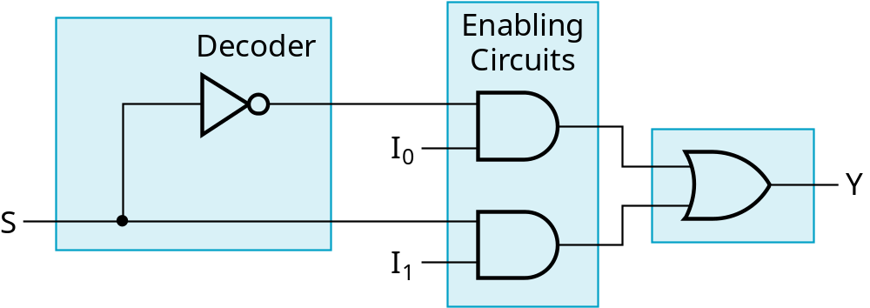
2-to-1-Line Multiplexer
Since 2 = 2¹, n = 1
The single selection variable S has two values:
  S = 0 selects input I₀
  S = 1 selects input I₁
The equation:
Y = I₀ + SI₁
The circuit:
S
Chapter 4 <number>

Slide 24
2-to-1-Line Multiplexer (continued)
Note the regions of the multiplexer circuit shown:
  1-to-2-line Decoder
  2 Enabling circuits
  2-input OR gate
To obtain a basis for multiplexer expansion, we combine the Enabling circuits and OR gate into a 2 × 2 AND-OR circuit:
  1-to-2-line decoder
  2 × 2 AND-OR
In general, for an 2^{n}-to-1-line multiplexer:
  n-to-2^{n}-line decoder
  2^{n} × 2 AND-OR
Chapter 4 <number>

Slide 25
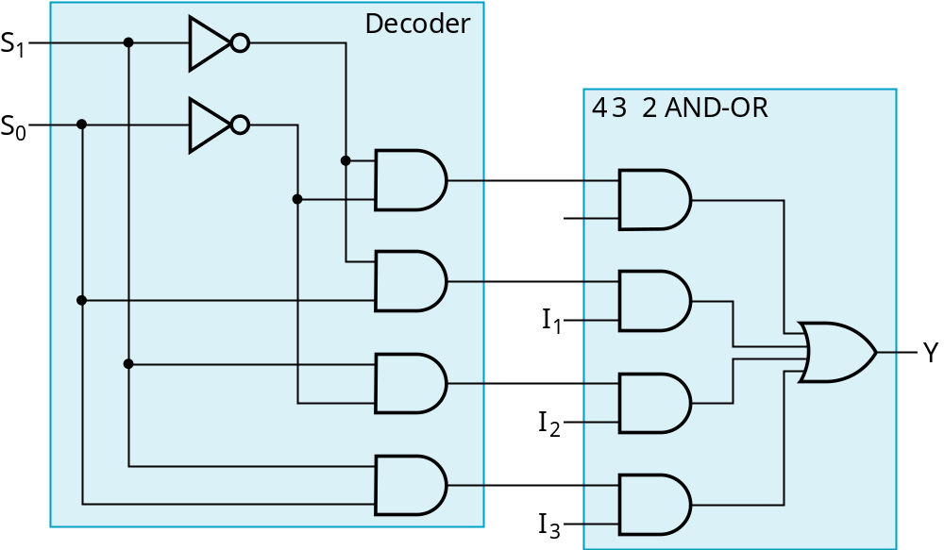
Example: 4-to-1-line Multiplexer
2-to-2²-line decoder
2² × 2 AND-OR
Chapter 4 <number>

Slide 26
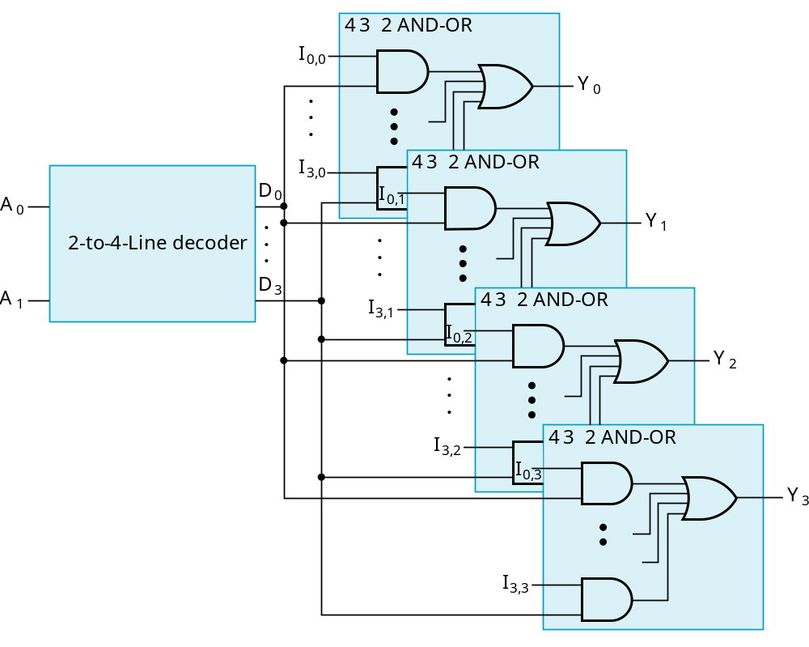
Multiplexer Width Expansion
Select “vectors of bits” instead of “bits”
Use multiple copies of 2^{n} × 2 AND-OR in parallel
Example:
4-to-1-line
quad multi-
plexer
Chapter 4 <number>

Slide 27
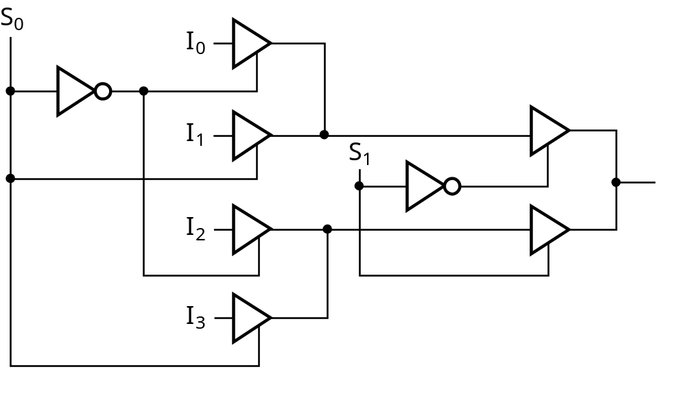
Other Selection Implementations
Three-state logic in place of AND-OR
Gate input cost = 14 compared to 22 (or 18) for gate implementation
Chapter 4 <number>

Slide 28
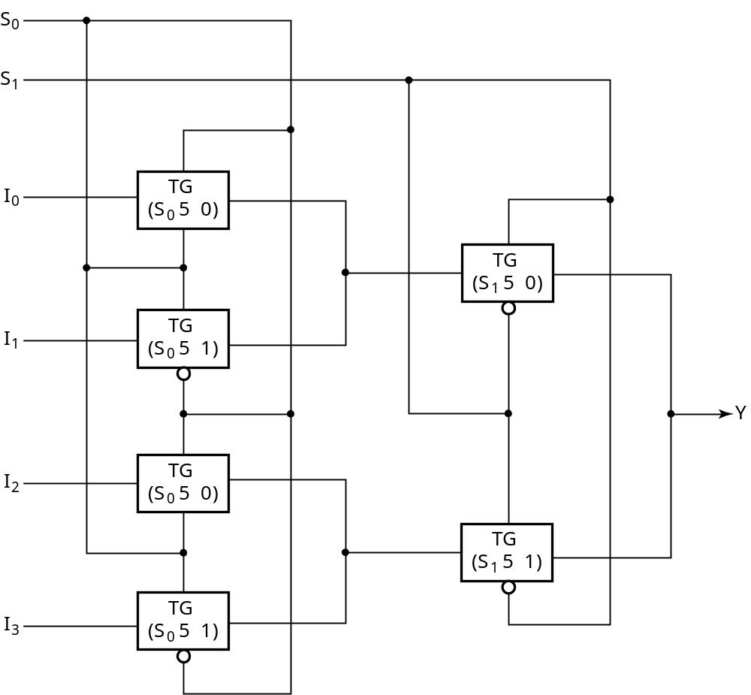
Other Selection Implementations
Transmission Gate Multiplexer
Gate input
cost = 8
compared
to 14 for
3-state logic
and 18 or 22
for gate logic
Chapter 4 <number>

Slide 29
Combinational Function Implementation
Alternative implementation techniques:
  Decoders and OR gates
  Multiplexers (and inverter)
  ROMs
  PLAs
  PALs
  Lookup Tables
Can be referred to as structured implementation methods since a specific underlying structure is assumed in each case
Chapter 4 <number>

Slide 30
Decoder and OR Gates
Implement m functions of n variables with:
  Sum-of-minterms expressions
  One n-to-2^{n}-line decoder
  m OR gates, one for each output
Approach 1:
  Find the truth table for the functions
  Make a connection to the corresponding OR from the corresponding decoder output wherever a 1 appears in the truth table
Approach 2
  Find the minterms for each output function
  OR the minterms together
Chapter 4 <number>

Slide 31
Decoder and OR Gates Example
Implement the following set of odd parity functions of (A₇, A₆, A₅, A₃)
P₁ = A₇ A₅ A₃
P₂ = A₇ A₆ A₃
P₄ = A₇ A₆ A₅
Finding sum of
minterms expressions
P₁ = Σ_{m}(1,2,5,6,8,11,12,15)
P₂ = Σ_{m}(1,3,4,6,8,10,13,15)
P₄ = Σ_{m}(2,3,4,5,8,9,14,15)
Find circuit
Is this a good idea?
+
+
A7
A6
A5
A4
P1
0
1
2
3
4
5
6
7
8
9
10
11
12
13
14
15
+
+
+
+
P2
P4
Chapter 4 <number>
Notes:
No. The complexity is high. Much better to implement the functions with XOR gates.
Also, the sharing of logic can cause 2 bits in error, which for this application
(a Hamming encoder) is not detectable! Note that XOR gates should not be shared in the implementation as well.

Slide 32
Multiplexer Approach 1
Implement m functions of n variables with:
  Sum-of-minterms expressions
  An m-wide 2^{n}-to-1-line multiplexer
Design:
  Find the truth table for the functions.
  In the order they appear in the truth table:
    Apply the function input variables to the multiplexer inputs S_{n − 1}, … , S₀
    Label the outputs of the multiplexer with the output variables
  Value-fix the information inputs to the multiplexer using the values from the truth table (for don’t cares, apply either 0 or 1)
Chapter 4 <number>

Slide 33
Example: Gray to Binary Code
Design a circuit to
convert a 3-bit Gray
code to a binary code
The formulation gives
the truth table on the
right
It is obvious from this
table that X = C and the
Y and Z are more complex
Gray
Binary
A B C
x y z
0
0
0
0
0
0
1 0
0
0
0 1
1
1 0
0 1 0
0 1 0
0 1
1
0 1
1
1 0
0
1
1
1
1 0 1
1 0 1
1
1 0
0
0 1
1
1
1
Chapter 4 <number>

Slide 34
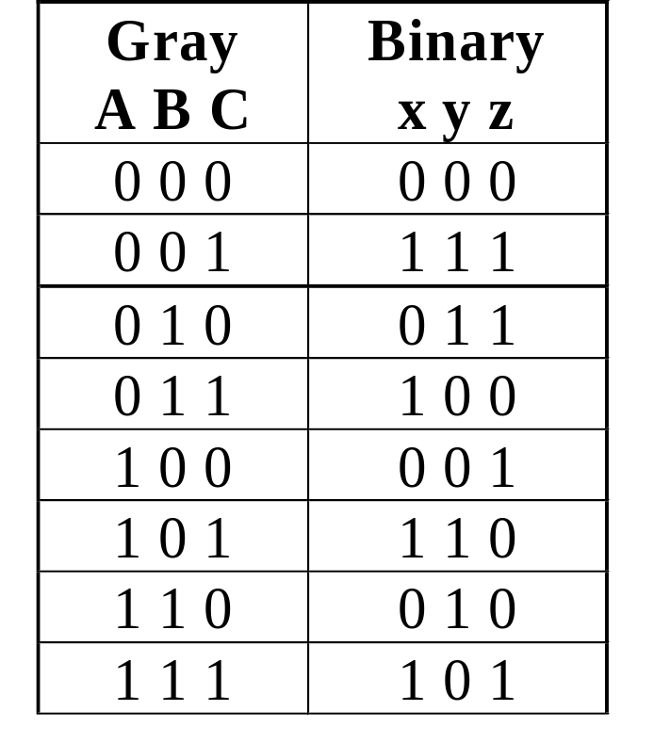
Gray to Binary (continued)
Rearrange the table so
that the input combinations
are in counting order
Functions y and z can
be implemented using
a dual 8-to-1-line
multiplexer by:
  connecting A, B, and C to the multiplexer select inputs
  placing y and z on the two multiplexer outputs
  connecting their respective truth table values to the inputs
Chapter 4 <number>

Slide 35
Gray to Binary (continued)
Note that the multiplexer with fixed inputs is identical to a ROM with 3-bit addresses and 2-bit data!
0
D00
0
D10
1
D01
1
D11
1
D02
1
D12
0
D03
0
D13
0
D04
1
D14
1
Out
Y
0
Out
Z
D05
D15
1
D06
0
D16
0
D07
1
D17
A
S2
A
S2
8-to-1
8-to-1
B
S1
B
S1
MUX
S0
MUX
C
S0
C
Chapter 4 <number>

Slide 36
Multiplexer Approach 2
Implement any m functions of n + 1 variables by using:
  An m-wide 2^{n}-to-1-line multiplexer
  A single inverter
Design:
  Find the truth table for the functions.
  Based on the values of the first n variables, separate the truth table rows into pairs
  For each pair and output, define a rudimentary function of the final variable (0, 1, X, )
  Using the first n variables as the index, value-fix the information inputs to the multiplexer with the corresponding rudimentary functions
  Use the inverter to generate the rudimentary function
X
X
Chapter 4 <number>

Slide 37
Example: Gray to Binary Code
Design a circuit to
convert a 3-bit Gray
code to a binary code
The formulation gives
the truth table on the
right
It is obvious from this
table that X = C and the
Y and Z are more complex
Gray
Binary
A B C
x y z
0
0
0
0
0
0
1 0
0
0
0 1
1
1 0
0 1 0
0 1 0
0 1
1
0 1
1
1 0
0
1
1
1
1 0 1
1 0 1
1
1 0
0
0 1
1
1
1
Chapter 4 <number>

Slide 38
Gray to Binary (continued)
Rearrange the table so that the input combinations are in counting order, pair rows, and find rudimentary functions
Gray A B C | Binary x y z | Rudimentary Functions of C for y | Rudimentary Functions of C for z
0 0 0 | 0 0 0
0 0 1 | 1 1 1
0 1 0 | 0 1 1
0 1 1 | 1 0 0
1 0 0 | 0 0 1
1 0 1 | 1 1 0
1 1 0 | 0 1 0
1 1 1 | 1 0 1
F = C
F = C
F = C
F = C
F = C
F = C
F = C
F = C
Chapter 4 <number>

Slide 39
Gray to Binary (continued)
Assign the variables and functions to the multiplexer inputs:
Note that this approach (Approach 2) reduces the cost by almost half compared to Approach 1.
This result is no longer ROM-like
Extending, a function of more than n variables is decomposed into several sub-functions defined on a subset of the variables. The multiplexer then selects among these sub-functions.
C
D00
C
D10
C
D01
C
D11
C
C
C
D02
Out
Y
C
D12
Out
Z
C
D03
C
D13
A
S1
8-to-1
A
S1
8-to-1
B
S0
MUX
B
S0
MUX
Chapter 4 <number>

Slide 40
Read Only Memory
Functions are implemented by storing the truth table
Other representations such as equations more convenient
Generation of programming information from equations usually done by software
Text Example 4-10 Issue
  Two outputs are generated outside of the ROM
  In the implementation of the system, these two functions are “hardwired” and even if the ROM is reprogrammable or removable, cannot be corrected or updated
Chapter 4 <number>

Slide 41
Programmable Array Logic
There is no sharing of AND gates as in the ROM and PLA
Design requires fitting functions within the limited number of ANDs per OR gate
Single function optimization is the first step to fitting
Otherwise, if the number of terms in a function is greater than the number of ANDs per OR gate, then factoring is necessary
Chapter 4 <number>

Slide 42
Programmable Array Logic Example
Equations: F1 = A + B + C + ABC
F2 = AB + BC + AC
F1 must be
factored
since four
terms
Factor out
last two
terms as W
B
C
A
C
A
B
AND
Inputs
Pr
od
uc
t
term
A B C D
W
Outputs
1
0
0
1
—
—
A
B
W = C
2
1
1
1
—
—
+ ABC
3
—
—
—
—
—
4
1
0
0
—
—
B
C
F1 = X = A
+ B + W
5
0
1
0
—
—
A
C
6
—
—
—
—
1
7
1
1
—
—
—
F2 = Y
= AB + BC +AC
8
—
1
1
—
—
9
1
—
1
—
—
10
—
—
—
—
—
11
—
—
—
—
—
12
—
—
—
—
—
Chapter 4 <number>

Slide 43
Programmable Array Logic Example
AND gates inputs
Product
A
A
B
B
C
C
D
D
W
W
term
1
X
X
X
2
X
X
X
W
3
X
A
4
X
X
X
All fuses intact
(always
5
0)
5
X
X
X
F1
6
X
B
7
X
X
8
X
X
F2
9
X
X
C
10
11
12
D
X
Fuse intact
1
Fuse blown
Chapter 4 <number>
A
A
B
B
C
C
D
D
W
W

Slide 44
Programmable Logic Array
The set of functions to be implemented must fit the available number of product terms
The number of literals per term is less important in fitting
The best approach to fitting is multiple-output, two-level optimization (which has not been discussed)
Since output inversion is available, terms can implement either a function or its complement
For small circuits, K-maps can be used to visualize product term sharing and use of complements
For larger circuits, software is used to do the optimization including use of complemented functions
Chapter 4 <number>

Slide 45
Programmable Logic Array Example
B
B
K-map
specification
How can this
be implemented
with four terms?
Complete the
programming table
BC
BC
A
00
01
11
10
A
00
01
11
10
0
0
1
0
1
0
0
0
1
0
A
1
1
0
0
0
A
1
0
1
1
1
C
C
F
1
5
A
BC + A B C + A B C
F
2
5
AB
+
AC
+ BC
F
1
5
AB + AC + BC + A B C
F
2
5
AC
+
AB
+
B
C
PLA programming table
Outputs
Product
Inputs
( )
(T)
term
A
B
C
F
1
F
2
AB
1
1
1
–
1
AC
2
1
–
1
1
BC
3
–
1
1
1
4
–
Chapter 4 <number>

Slide 46
Programmable Logic Array Example
A
B
C
X
X
1
X
X
X
X
2
X
X
X
Fuse intact
1
Fuse blown
X
X
3
X
X
X
X
X
4
X
C
C
B
B
A
A
X
0
X
1
F
1
F
2
Chapter 4 <number>

Slide 47
Lookup Tables
Lookup tables are used for implementing logic in Field-Programmable Gate Arrays (FPGAs) and Complex Logic Devices (CPLDs)
Lookup tables are typically small, often with four inputs, one output, and 16 entries
Since lookup tables store truth tables, it is possible to implement any 4-input function
Thus, the design problem is how to optimally decompose a set of given functions into a set of 4-input two- level functions.
We will illustrate this by a manual attempt
Chapter 4 <number>

Slide 48
Lookup Table Example
Equations to be implemented:
F₁(A,B,C,D,E) = A D E + B D E + C D E F₂(A,B,D,E,F) = A E D + B D E + F D E
Extract 4-input function:
F₃(A,B,D,E) = A D E + B D E
F₁(C,D,E,F₃) = F₃ + C D E
F₂(D,E,F,F₃) = F₃ + F D E
The cost of the solution is 3 lookup tables
Chapter 4 <number>

Slide 49
Terms of Use
© 2004 by Pearson Education,Inc. All rights reserved.
The following terms of use apply in addition to the standard Pearson Education Legal Notice.
Permission is given to incorporate these materials into classroom presentations and handouts only to instructors adopting Logic and Computer Design Fundamentals as the course text.
Permission is granted to the instructors adopting the book to post these materials on a protected website or protected ftp site in original or modified form. All other website or ftp postings, including those offering the materials for a fee, are prohibited.
You may not remove or in any way alter this Terms of Use notice or any trademark, copyright, or other proprietary notice, including the copyright watermark on each slide.
Return to Title Page
Chapter 4 <number>

